Slide 1
Operating Systems (Process Synchronization)
Presented By Sudeshna Kundu (Mondal)

Slide 2
Independent and Cooperating process
Processes that executing concurrently in the operating system may be either independent processes or cooperating processes.
If a process cannot affect or be affected by the other processes executing in the system then the process is said to be independent.
A co-operating process can be affected by other executing processes. Cooperating processes need Inter Process Communication (IPC)
Advantages of process cooperation
Information sharing
Computation speed-up
Modularity
Convenience
Inter process communication (IPC) is a mechanism which allows processes to communicate each other and synchronize their actions.

Slide 3
Advantages of process cooperation
Information sharing - Since several users may be interested in the same piece of information (for instance, a shared file), we must provide an environment to allow concurrent access to such information.
Computation speedup - If we want a particular task to run faster, we must break it into subtasks, each of which will be executing in parallel with the others.
Modularity - We can construct the system in a modular fashion, dividing the system functions into separate processes or threads.
Convenience - Even an individual user can work on many tasks at the same time like a user can be editing, listening to music, and compiling in parallel.

Slide 4
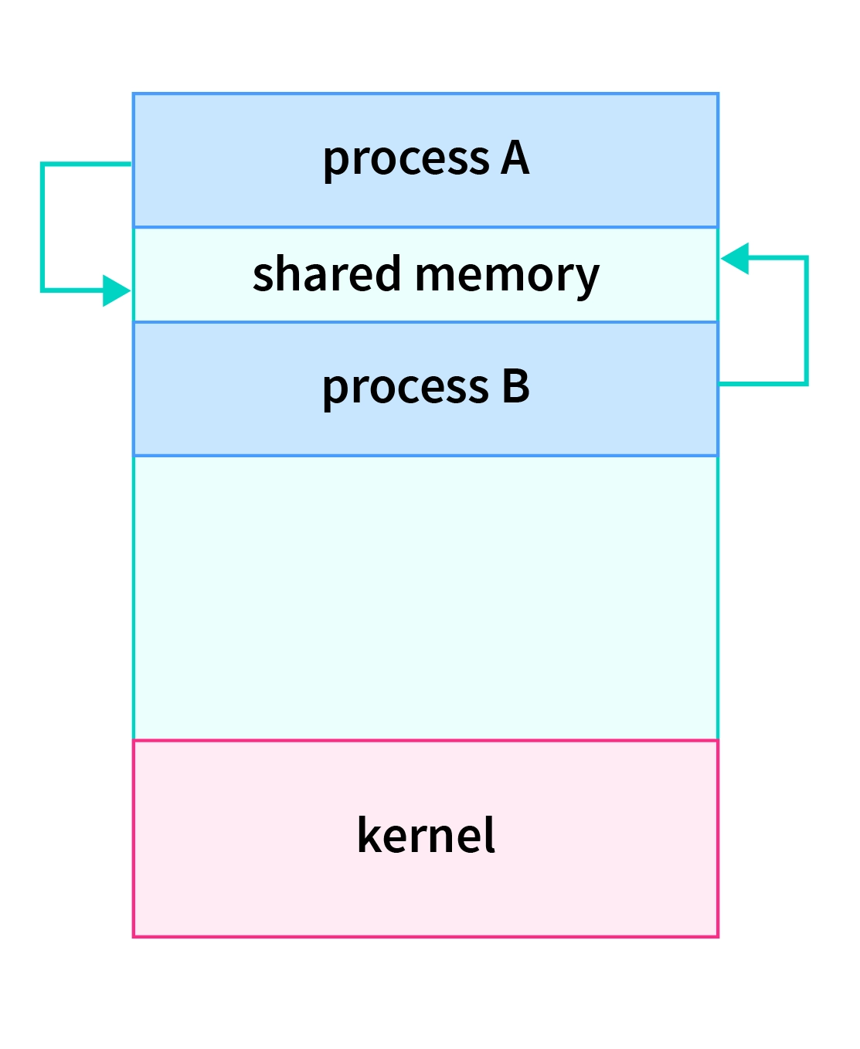
Inter-process communication (IPC)
Cooperating processes need an inter-process communication (IPC) mechanism that will allow them to exchange data and information. Two basic models of inter-process communication are there:
Shared memory and message passing.
A region of memory that is shared by cooperating processes is established, in shared-memory model.
Shared Memory
Multiple processes can access a common shared memory. Multiple processes communicate by shared memory, where one process makes changes at a time and then others view the change. Shared memory does not use kernel.
The advantage with this is that the communication is extremely fast, there are no system calls which are involved.
Limitation: Error prone, Needs synchronization between processes.

Slide 5
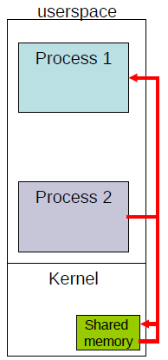
Inter-process communication (IPC)
Message passing
Shared memory is created as part of the user space
In message passing the shared memory is created in the kernel
Essentially we would then require system call such as send and receive in order to communicate between the two processes
If a process 2 wants to send data to process 1, it will invoke the send system call. So this would then cause the kernel to execute and it would result in the data return into the shared memory.
When process 1 invokes receive, data from the shared memory would be read by process 1.
The advantage of this particular message passing is that the sharing is explicit. Essentially both process 1 and process 2 would require support for the kernel to transfer data between each other.
The limitations is that it is slow, each system call has significant overheads. Therefore, message passing is quite slow compared to shared memory.
However, it is less error prone then shared memory because the kernel manages the sharing, and therefore would be able to do the synchronization between the process 1 and process 2.

Slide 6
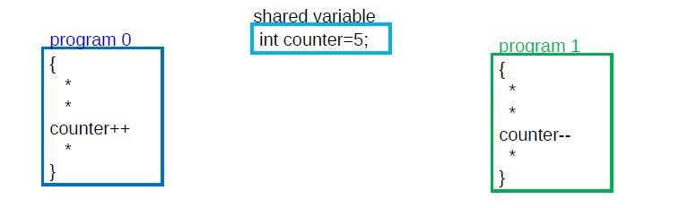
What can be the output?

Slide 7
Race Condition
counter++ could be implemented as register1 = counter register1 = register1 + 1 counter = register1
counter-- could be implemented as register2 = counter register2 = register2 - 1 counter = register2
Consider this execution interleaving with “count = 5” initially:
S0: producer execute register1 = counter {register1 = 5} S1: producer execute register1 = register1 + 1 {register1 = 6} S2: consumer execute register2 = counter {register2 = 5} S3: consumer execute register2 = register2 – 1 {register2 = 4} S4: producer execute counter = register1 {counter = 6 } S5: consumer execute counter = register2 {counter = 4}

Slide 8
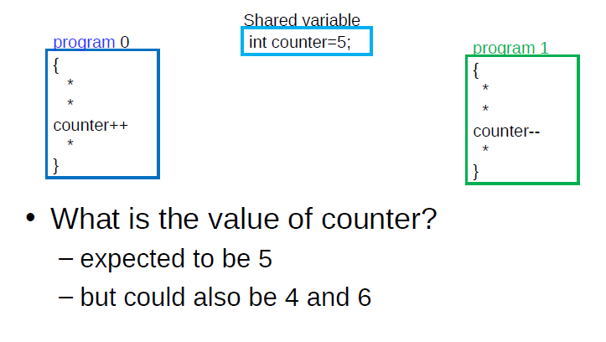
Motivation for Synchronization

Slide 9
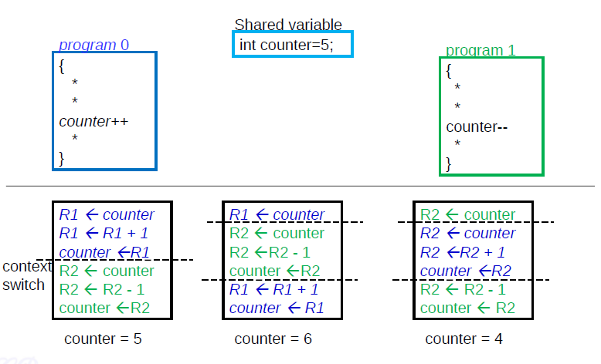
Motivation for Synchronization

Slide 10
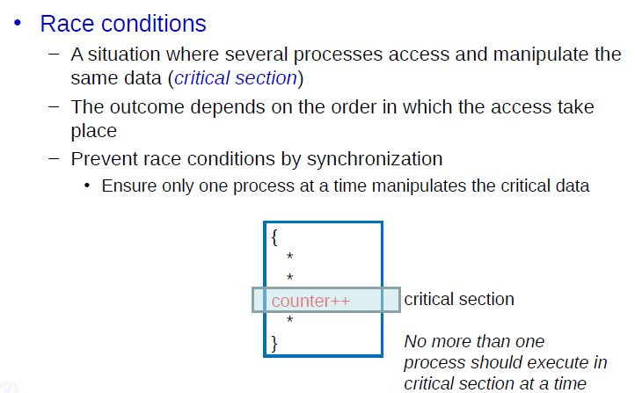
Race Condition

Slide 11
Race Condition
A Race Condition is a situation where several processes access and manipulate the same data. So this part of the process which accesses common or the shared data is known as a Critical Section.
The outcome of a race condition would depend on the order in which the accesses to that data take place.
Depending on which program executes first as well as depending on how the context switch is occur the result would vary.
The race conditions could be prevented by what is known as synchronization.
Essentially, with synchronization we would ensure that only one process at a time would manipulate the critical data

Slide 12
Race Condition
Race condition: The situation where several processes access – and manipulate shared data concurrently. The final value of the shared data depends upon which process finishes last
To prevent race conditions, concurrent processes must be synchronized

Slide 13
Producer-Consumer problem
The Producer-Consumer problem is a classical multi-process synchronization problem, that is we are trying to achieve synchronization between more than one process.
There is one Producer in the producer-consumer problem, Producer is producing some items, whereas there is one Consumer that is consuming the items produced by the Producer. The same memory buffer is shared by both producers and consumers which is of fixed-size.
The task of the Producer is to produce the item, put it into the memory buffer, and again start producing items. Whereas the task of the Consumer is to consume the item from the memory buffer.

Slide 14
Producer-Consumer problem
Producer
The producer should produce data only when the buffer is not full. In case it is found that the buffer is full, the producer is not allowed to store any data into the memory buffer.
Data can only be consumed by the consumer if and only if the memory buffer is not empty. In case it is found that the buffer is empty, the consumer is not allowed to use any data from the memory buffer.
Accessing memory buffer should not be allowed to producer and consumer at the same time.
while (true) { /* produce an item in next produced */
while (counter == BUFFER_SIZE) ;
/* do nothing */
buffer[in] = next_produced;
in = (in + 1) % BUFFER_SIZE;
counter++;
}

Slide 15
Producer-Consumer problem
Consumer
counter =0, BUFFER_SIZE=5,
while (true) {
while (counter == 0)
; /* do nothing */
next_consumed = buffer[out];
out = (out + 1) % BUFFER_SIZE;
counter--;
/* consume the item in next consumed */
}
Producer
x1 has been removed
x1
while (true) { /* produce an item in next produced */
while (counter == BUFFER_SIZE) ;
/* do nothing */
buffer[in] = next_produced;
in = (in + 1) % BUFFER_SIZE;
counter++;
}
in
out
counter
0
0
0
1
0
1
1
1
0

Slide 16
The Critical-Section Problem
n processes all competing to use some shared data
Each process has a code segment, called critical section, in which the shared data is accessed
Problem – ensure that when one process is executing in its critical section, no other process is allowed to execute in its critical section

Slide 17
Critical Section Problem
Consider system of n processes {p₀, p₁, … p_{n-1}}
Each process has critical section segment of code
Process may be changing common variables, updating table, writing file, etc
When one process in critical section, no other may be in its critical section
Critical section problem is to design protocol to solve this
Each process must ask permission to enter critical section in entry section, may follow critical section with exit section, then remainder section

Slide 18
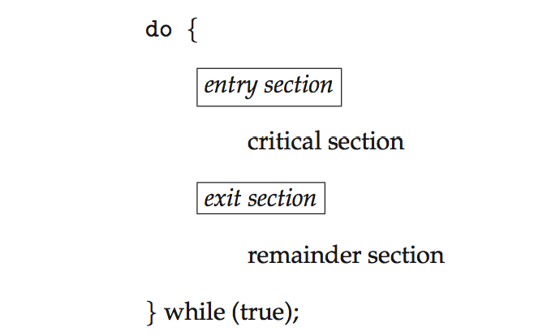
Critical Section
General structure of process P_{i}

Slide 19
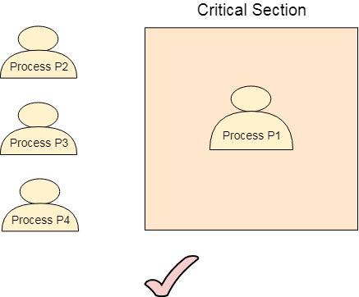
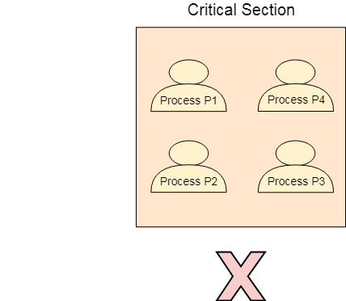
Solution to critical section problem
1. Mutual Exclusion - If process P_{i} is executing in its critical section, then no other processes can be executing in their critical sections
2. Progress - If no process is executing in its critical section and there exist some processes that wish to enter their critical section, then the selection of the processes that will enter the critical section next cannot be postponed indefinitely
3. Bounded Waiting - A bound must exist on the number of times that other processes are allowed to enter their critical sections after a process has made a request to enter its critical section and before that request is granted

Slide 20
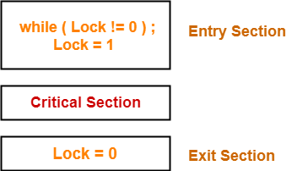
Synchronization using LOCK variable
This is a Software Mechanism implemented in User mode. This can be used for more than two processes.
Lock value = 0 means the critical section is currently vacant and no process is present inside it.
Lock value = 1 means the critical section is currently occupied and a process is present inside it.
Scene-01:
Process P₀ arrives.
It executes the lock!=0 instruction.
Since lock value is set to 0, so it returns value 0 to the while loop.
The while loop condition breaks.
It sets the lock value to 1 and enters the critical section.
Now, even if process P₀ gets preempted in the middle, no other process can enter the critical section.
Any other process can enter only after process P₀ completes and sets the lock value to 0.

Slide 21
Synchronization using LOCK variable
Scene-02:
Another process P₁ arrives.
It executes the lock!=0 instruction.
Since lock value is set to 1, so it returns value 1 to the while loop.
The returned value 1 does not break the while loop condition.
The process P₁ is trapped inside an infinite while loop.
The while loop keeps the process P₁ busy until the lock value becomes 0 and its condition breaks.

Slide 22
Synchronization using LOCK variable
Scene-03:
P0 gets into the entry section. Since the value of lock is 0 hence P0 tries to change its value from 0 to 1 and enters into the critical section.
Meanwhile, P0 is preempted by the CPU and P1 gets scheduled. Now there is no other process in the critical section and the value of lock variable remains 0. P1 also wants to execute its critical section. It enters into the critical section by setting the lock variable to 1.
Now, CPU changes P0's state from waiting to running. P0 is yet to finish its critical section. P0 has already checked the value of lock variable and remembers that its value was 0 when it previously checked it. Hence, it also enters into the critical section without checking the updated value of lock variable.
Now, we got two processes in the critical section. According to the condition of mutual exclusion, more than one process in the critical section must not be present at the same time. Hence, the lock variable mechanism doesn't guarantee the mutual exclusion.

Slide 23
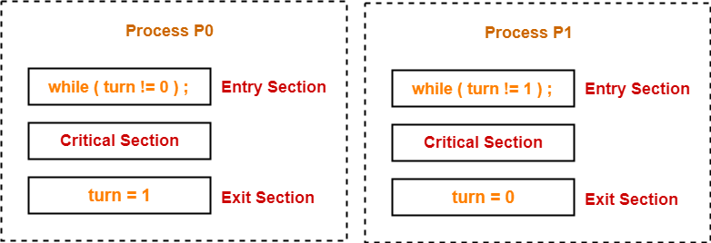
Synchronization using TURN variable or Strict Alternation Approach
Turn variable is a synchronization mechanism that provides synchronization among two processes.
It uses a turn variable to provide the synchronization.
Initially, turn value is set to 0.
Turn value = 0 means it is the turn of process P0 to enter the critical section.
Turn value = 1 means it is the turn of process P1 to enter the critical section.

Slide 24
Synchronization using TURN variable
Scene-01:
Process P₀ arrives.
It executes the turn!=0 instruction.
Since turn value is set to 0, so it returns value 0 to the while loop.
The while loop condition breaks.
Process P₀ enters the critical section and executes.
Now, even if process P₀ gets preempted in the middle, process P₁ can not enter the critical section.
Process P₁ can not enter unless process P₀ completes and sets the turn value to 1.

Slide 25
Synchronization using TURN variable
Scene-02:
Process P₁ arrives.
It executes the turn!=1 instruction.
Since turn value is set to 0, so it returns value 1 to the while loop.
The returned value 1 does not break the while loop condition.
The process P₁ is trapped inside an infinite while loop.
The while loop keeps the process P₁ busy until the turn value becomes 1 and its condition breaks.

Slide 26
Synchronization using TURN variable
Scene-03:
Process P₀ comes out of the critical section and sets the turn value to 1.
The while loop condition of process P₁ breaks.
Now, the process P₁ waiting for the critical section enters the critical section and execute.
Now, even if process P₁ gets preempted in the middle, process P₀ can not enter the critical section.
Process P₀ can not enter unless process P₁ completes and sets the turn value to 0.

Slide 27
Synchronization using TURN variable
Mutual Exclusion
The strict alternation approach provides mutual exclusion in every case. This procedure works only for two processes. The pseudo code is different for both of the processes. The process will only enter when it sees that the turn variable is equal to its Process ID otherwise not Hence No process can enter in the critical section regardless of its turn.
Progress
Progress is not guaranteed in this mechanism. If Pi doesn't want to get enter into the critical section on its turn then Pj got blocked for infinite time. Pj has to wait for so long for its turn since the turn variable will remain 0 until Pi assigns it to j.

Slide 28

Peterson’s Solution

Slide 29
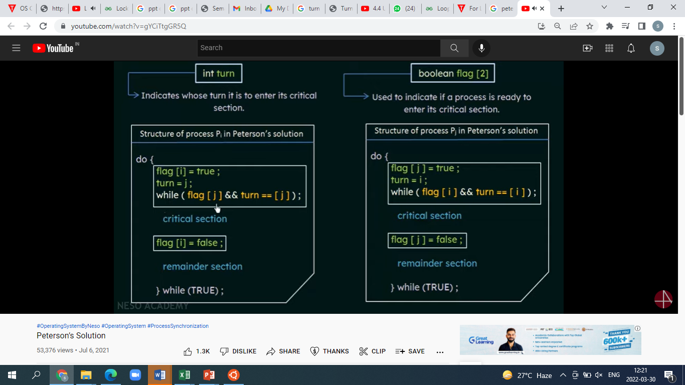
Peterson’s Solution

Slide 30
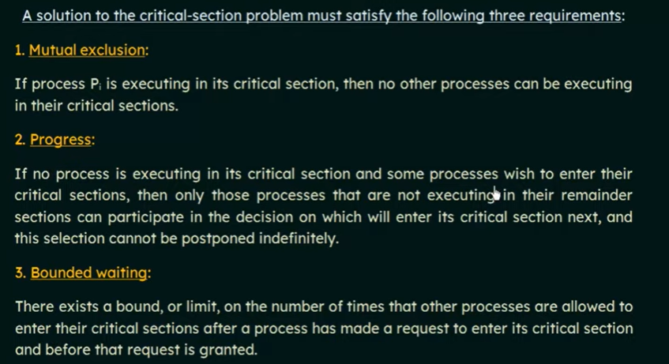
Peterson’s Solution (Cont.)

Slide 31
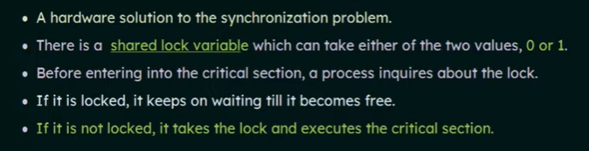
test_and_set Instruction
Shared Boolean variable lock, initialized to FALSE
Solution:
do { while (test_and_set(&lock))
; /* do nothing */
/* critical section */
lock = false;
/* remainder section */
} while (true);

Slide 32
test_and_set Instruction
Shared Boolean variable lock, initialized to FALSE
Solution:
do { while (test_and_set(&lock))
; /* do nothing */
/* critical section */
lock = false;
/* remainder section */
} while (true);
boolean test_and_set (boolean *target)
{
boolean rv = *target;
*target = TRUE;
return rv:
}
Executed atomically
Returns the original value of passed parameter
Set the new value of passed parameter to “TRUE”.
lock
target
r
false
1000
1000
lock
target
r
true
1000
false
1000
lock
target
r
true
1000
true
1000

Slide 33
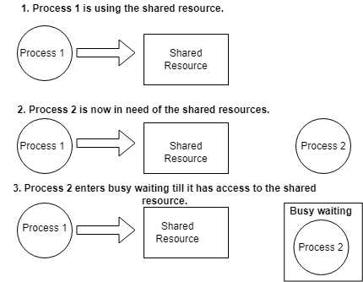
Busy waiting
Busy waiting, also known as spinning, or busy looping is a process synchronization technique in which a process/task waits and constantly checks for a condition to be satisfied before proceeding with its execution.

Slide 34
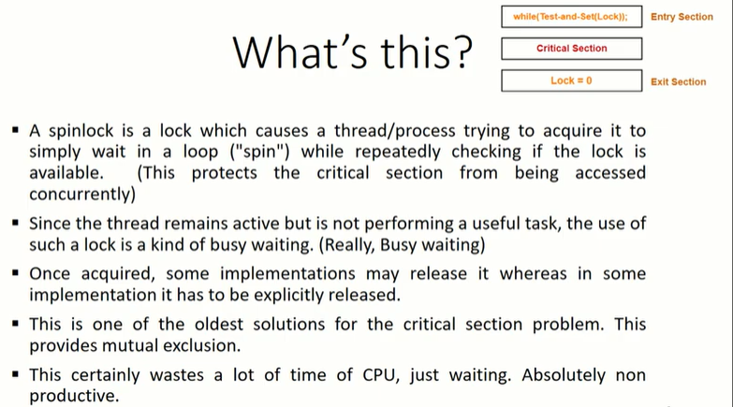
Spinlock

Slide 35
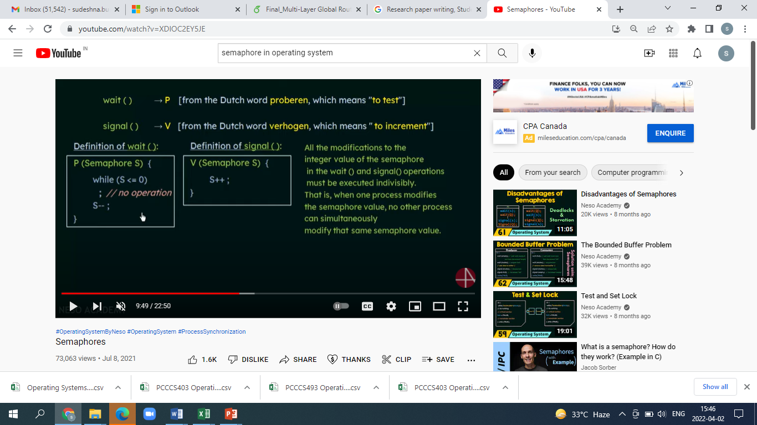
Semaphore
Semaphores are integer variables that are used to solve the critical section problem by using two atomic operations, wait and signal that are used for process synchronization.
Wait(): The wait operation decrements the value of its argument S, if it is positive. If S is negative or zero, then no operation is performed.
Signal(): The signal operation increments the value of its argument S.

Slide 36
Types of Semaphore
Counting Semaphores: These are integer value semaphores and have an unrestricted value domain. These semaphores are used to coordinate the resource access, where the semaphore count is the number of available resources. If the resources are added, semaphore count automatically incremented and if the resources are removed, the count is decremented.
Binary Semaphores: The binary semaphores are like counting semaphores but their value is restricted to 0 and 1. The wait operation only works when the semaphore is 1 and the signal operation succeeds when semaphore is 0. It is sometimes easier to implement binary semaphores than counting semaphores.

Slide 37
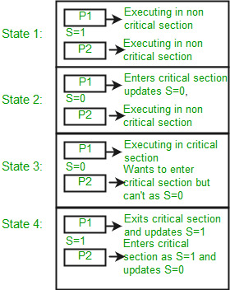
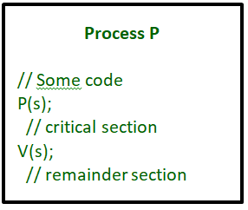

Slide 38
Mutex
Mutex and Semaphore both provide synchronization services but they are not the same. Details about both Mutex and Semaphore are given below −
Mutex
Mutex is a mutual exclusion object that synchronizes access to a resource. It is created with a unique name at the start of a program. The Mutex is a locking mechanism that makes sure only one thread can acquire the Mutex at a time and enter the critical section. This thread only releases the Mutex when it exits the critical section.
This is shown with the help of the following example −
wait (mutex);
…..
Critical Section
…..
signal (mutex);
A Mutex is different than a semaphore as it is a locking mechanism while a semaphore is a signalling mechanism. A binary semaphore can be used as a Mutex but a Mutex can never be used as a semaphore.

Slide 39
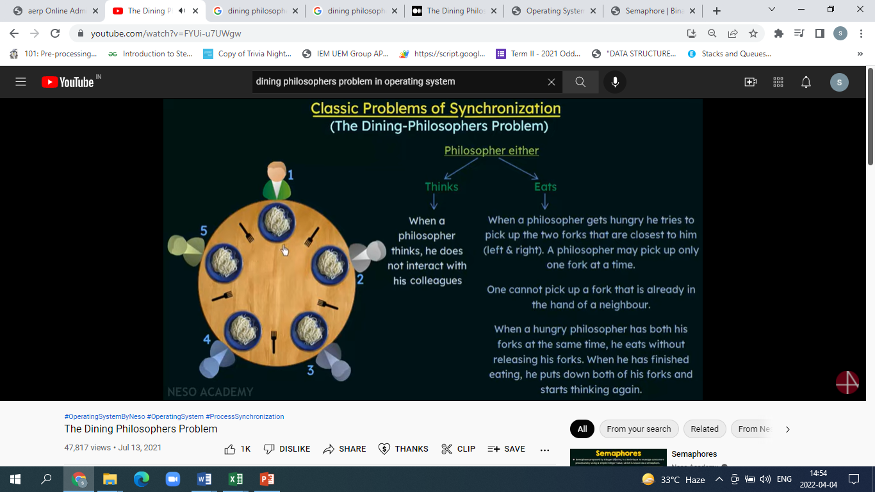

The Dining Philosophers Problem

Slide 40
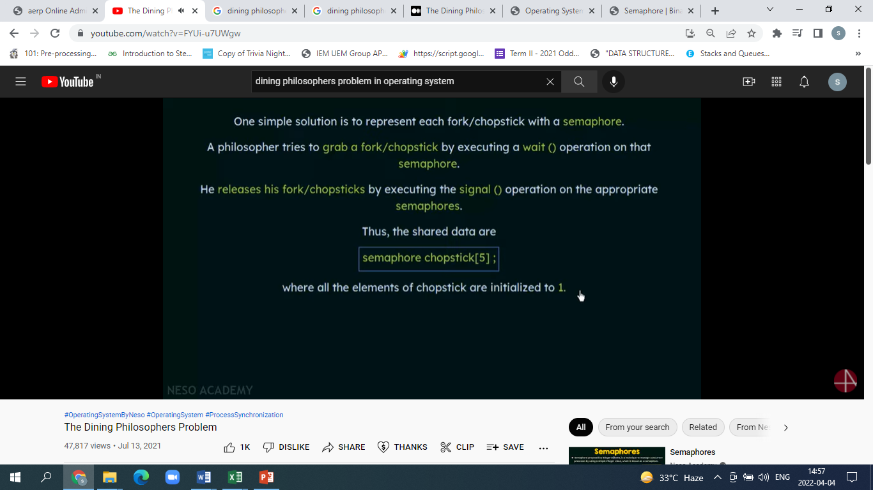
The Dining Philosophers Problem

Slide 41
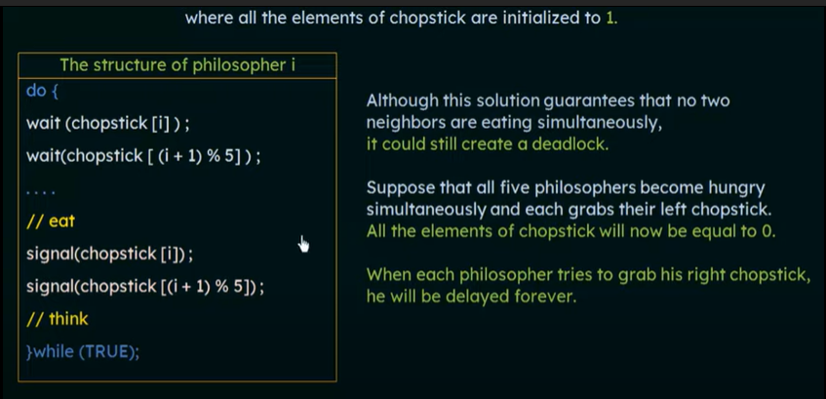
The Dining Philosophers Problem

Slide 42
The Dining Philosophers Problem
Deadlock handling
Allow at most 4 philosophers to be sitting simultaneously at the table.
Allow a philosopher to pick up the forks only if both are available (picking must be done in a critical section.
Use an asymmetric solution -- an odd-numbered philosopher picks up first the left chopstick and then the right chopstick. Even-numbered philosopher picks up first the right chopstick and then the left chopstick.

Slide 43
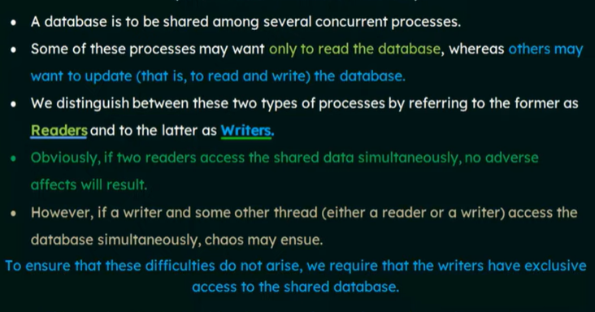
The Readers Writers Problem

Slide 44
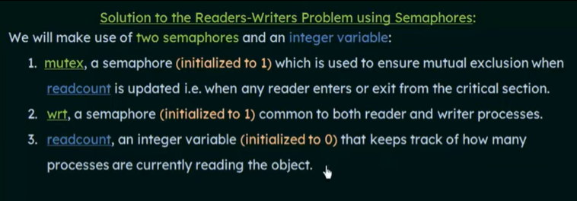
The Readers Writers Problem

Slide 45
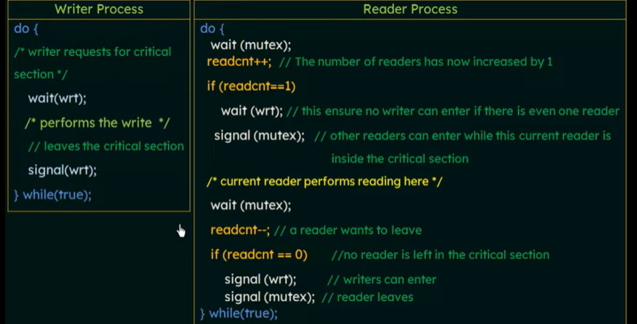
The Readers Writers Problem

Slide 46
Monitors
monitor monitorName
{
data variables;
Procedure P1(....)
{
}
Procedure P2(....)
{
}
Procedure Pn(....)
{
}
Initialization Code(....)
{
}
}
Monitors are a synchronization construct that were created to overcome the problems caused by semaphores such as timing errors.
Monitors are abstract data types and contain shared data variables and procedures. The shared data variables cannot be directly accessed by a process and procedures are required to allow a single process to access the shared data variables at a time.
Only one process can be active in a monitor at a time. Other processes that need to access the shared variables in a monitor have to line up in a queue and are only provided access when the previous process release the shared variables.

Slide 47
THANK YOU

